Slide 1

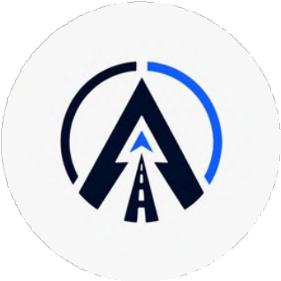

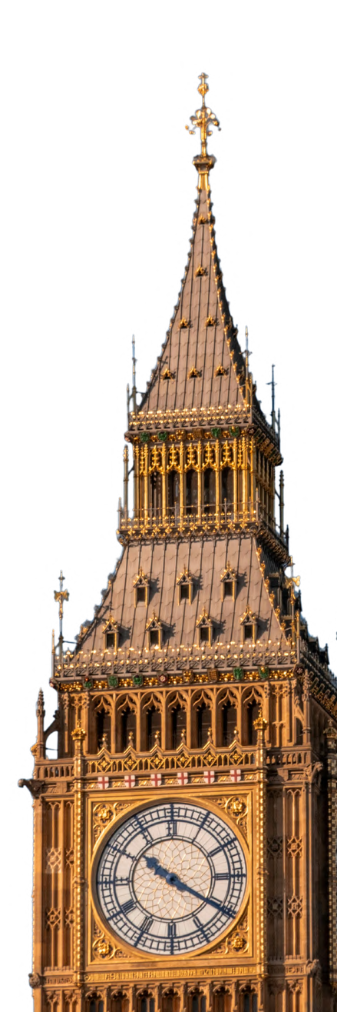
ALEROPATH CONNECT
The Community Engine
Presented by
Team-404 found

Slide 2
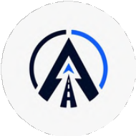



The Problem
Missed Opportunities
Students can miss relevant events, projects, resources, and opportunities.
Hard to Find the Right People
Students struggle to connect with people who have similar interests, skills, and goals.
Collaboration is Fragmented
Finding projects, teammates, ideas, and meaningful work is difficult.
Limited Organizer Tools
Organizers need better ways to engage members, share opportunities and organize activities.
“There is no single connected experience that brings people, opportunities, activities, and collaboration together.”

Slide 3


Our Vision
DISCOVER
Find what matters Opportunities
Events
Projects
Resources
CONNECT
Meet the right people
Skills
Interest
Goals
COLLABORATE
Build together
Teams
Ideas
Projects
GROW
Grow together
Learn
Participate
Contribute
One connected ecosystem for people, opportunities, and meaningful collaboration.

Slide 4

The Solution
A Unified Digital Community Ecosystem
DISCOVER
CONNECT
Discover events , projects, opportunities , resource and people in one place
CONNECTOR
ONE CONNECTED ECOSYSTEM
Connect with people based on skills, interests, goals and project need
GROWTH
COLLABORATE
Learn, participate, contribute, grow your network and achieve your goals.
Work on projects, find teammates, share ideas, communicate and build amazing things together.

Slide 5


How It Works
Sign Up
Explore
Connect
Collaborate
Grow & Succeed
Create your profile and tell us about your skills, interests and goals.
Discover projects, hackathons, events and people based on your interests.
Find teammates, mentors and like-minded individuals and connect with them.
Share ideas, build together and track your progress seamlessly.
Learn, grow your network and achieve your goals together.

Slide 6
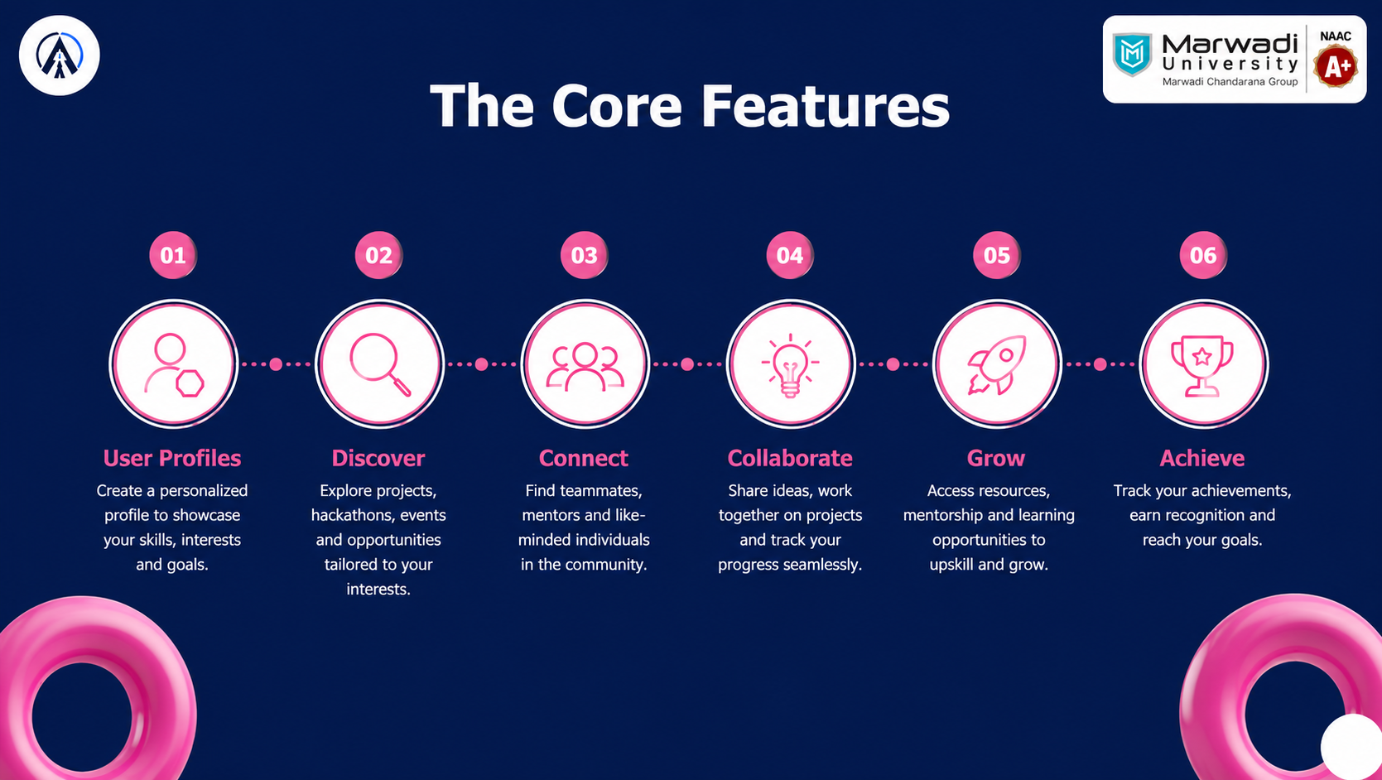


The Core Features

Slide 7
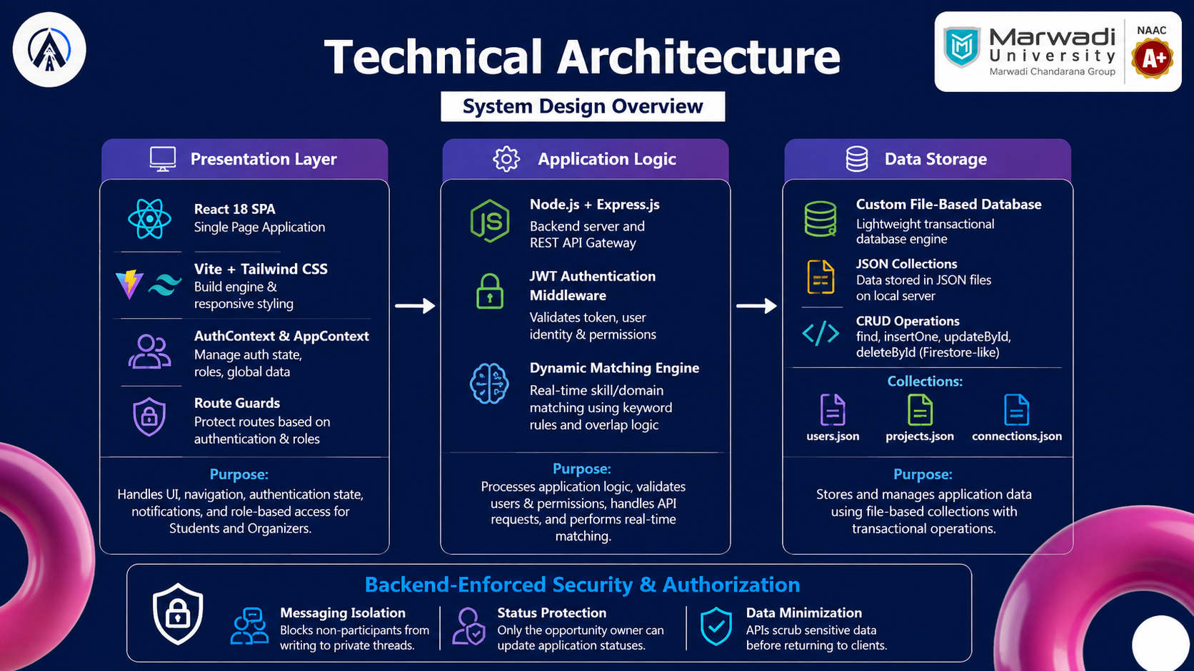


Technical Architecture
System Design Overview

Slide 8
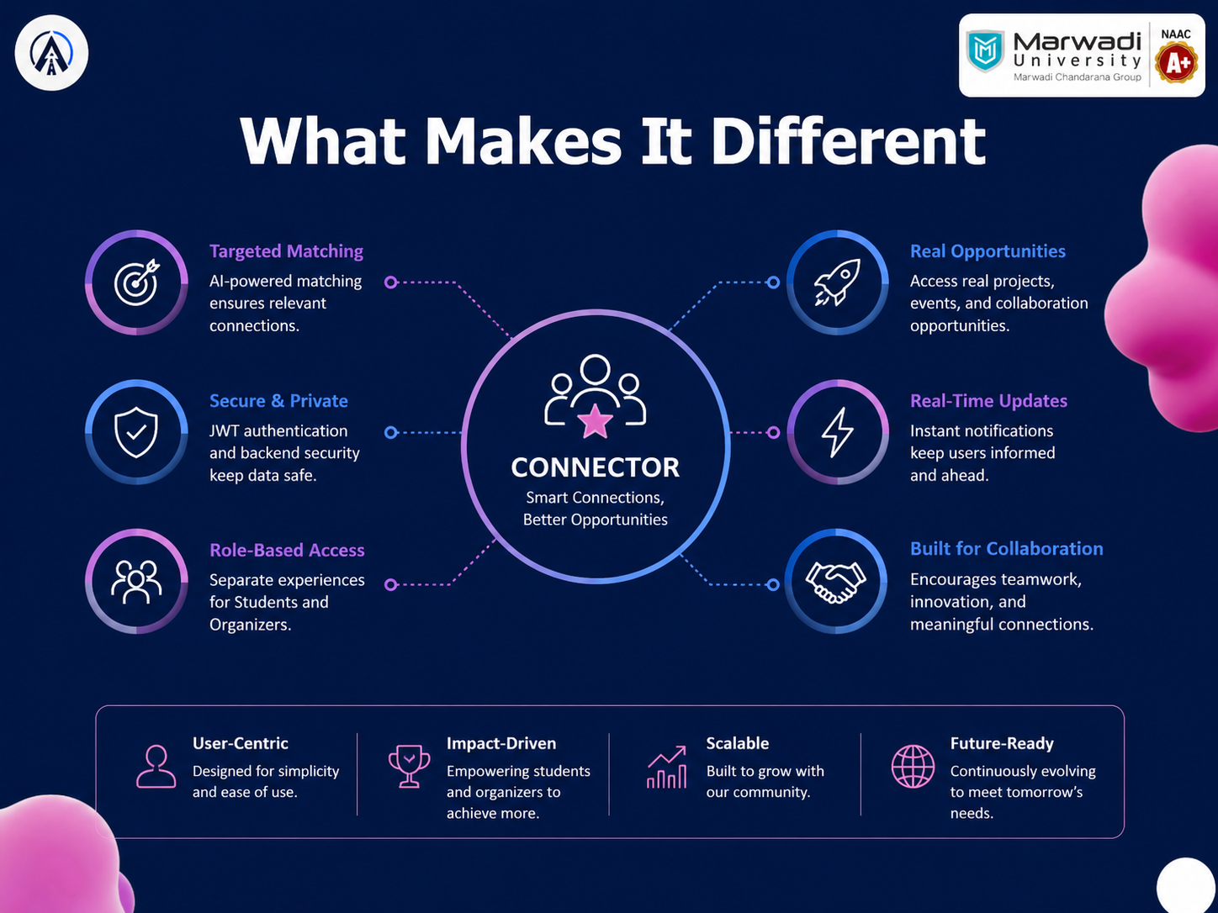


What Makes It Different

Slide 9
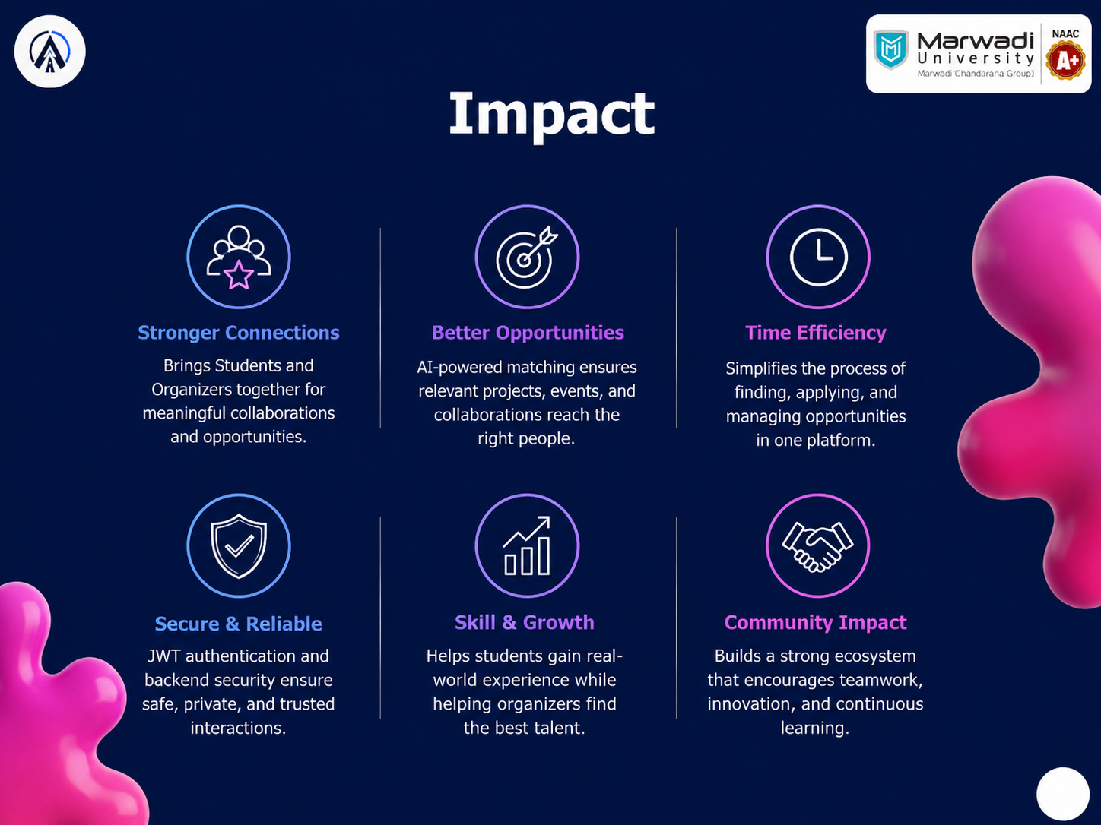


Impact

Slide 10
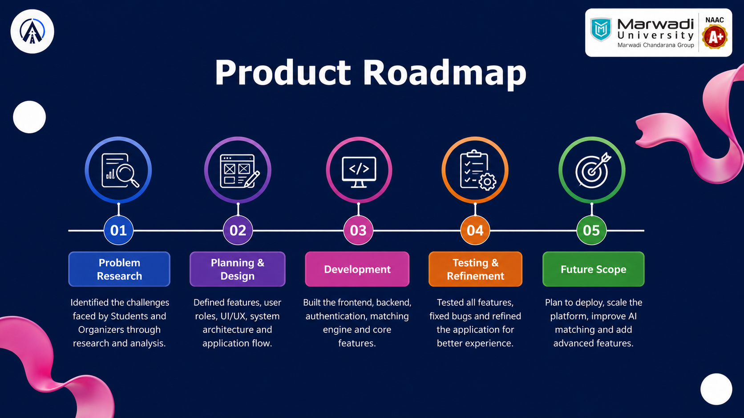


Product Roadmap

Slide 11
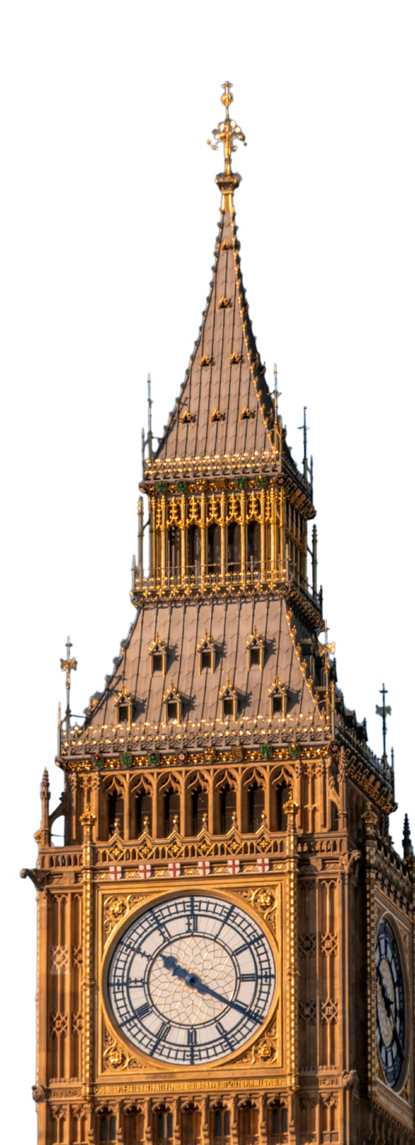







THANK YOU

